Slide 1
Software Development Life Cycle (SDLC)
Phases, Models, and Comparisons
-Priyanshu Dhyani

Slide 2
Software Development Life Cycle (SDLC)
Planning: Define scope, objectives, and constraints.
Requirements Analysis: Gather and document requirements.
Design: Create software architecture and detailed design.
Development: Write and compile code.
Testing: Verify functionality and identify defects.
Deployment: Release software to users.
Maintenance: Ongoing support and updates.

Slide 3
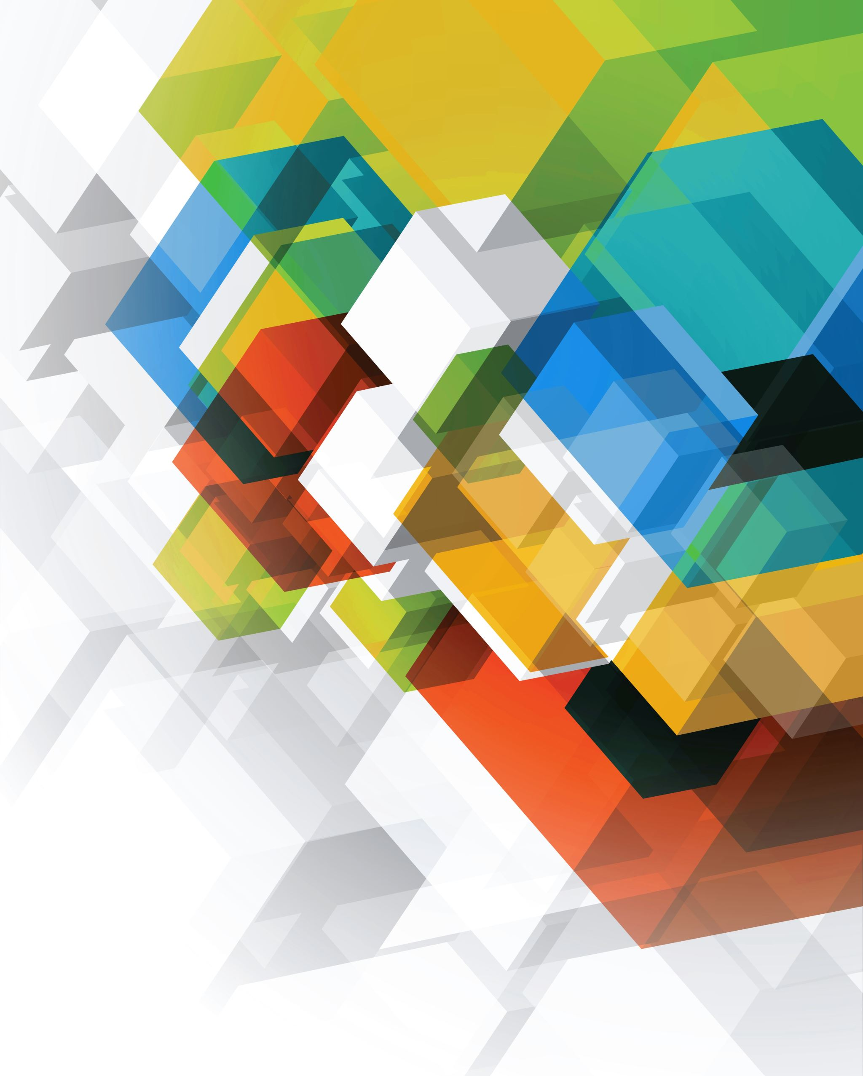
Overview of SDLC Models
Waterfall Model
Agile Model
Spiral Model
V-Model

Slide 4
Waterfall Model
Description:
Linear and sequential approach.
Each phase must be completed before the next begins.
Pros:
Simple and easy to understand.
Clear milestones and deliverables.
Cons:
Inflexible to changes.
High risk of finding issues late.

Slide 5
Agile Model
Description:
Iterative and incremental approach.
Development divided into sprints with regular stakeholder feedback.
Pros:
Flexible and adaptive.
Promotes continuous improvement and customer satisfaction.
Cons:
Requires high collaboration.
Can be challenging to manage.

Slide 6
Spiral Model
Description:
Combines iterative and waterfall elements.
Emphasizes risk assessment and reduction.
Pros:
Focus on risk management.
Suitable for complex projects.
Cons:
Can be costly and time-consuming.
Requires expertise in risk analysis.

Slide 7
V-Model
Description
Extension of waterfall with emphasis on testing.
Each development phase has a corresponding testing phase.
Pros:
Structured with a focus on quality.
Easy to manage and track.
Cons:
Inflexible to changes.
Can be costly due to extensive testing.

Slide 8
Conclusion
SDLC Phases: Essential for structured and efficient software development.
Model Comparison:
Waterfall: Simple but inflexible.
Agile: Flexible but complex to manage.
Spiral: Risk-focused but costly.
V-Model: Quality-focused but inflexible.
Choosing the Right Model: Depends on project requirements, risk factors, and team dynamics.

Slide 9
THANK YOU

